Slide 1

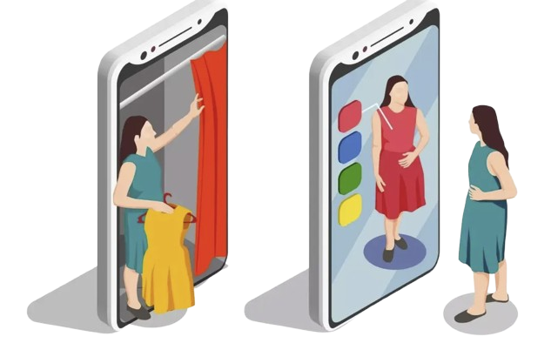
Project Presentation on
“Ai driven virtual try-on system in
E-Commerce“

Slide 2

1
CSE299
Junior design Project
Group Number:
1
Group name:
Caffeine Overflow’s
Group Members:
Aporbo Ghosh-1931458
2. Tasfia Anjum Zuairia- 2221233

Slide 3

2
Roadmap for the Presentation
Homepage glimpse
Introduction and
Motivation
Customer Benifits
Review of exsting work
Proposal Highlights
Implementation Details
Implemented Features
Functional Details
Special Featur
Methodology
Technology Used
Not Implemented Features
Limitations
Result Details
Future enhancement
Learnings
contribution
Conclusion
Thank you

Slide 4
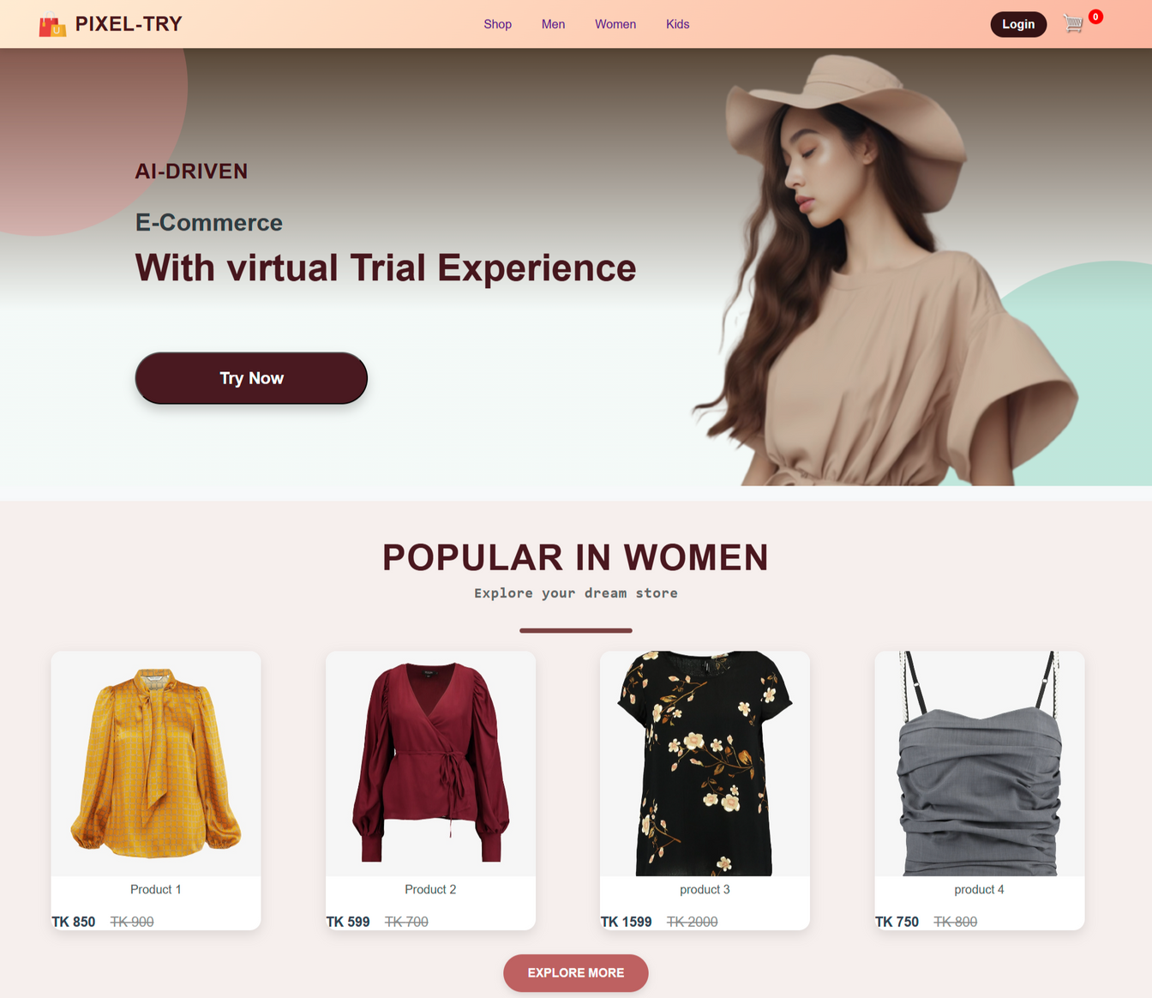
3
First Page of Pixel-Try

Slide 5

4
Introduction
- What does an AI- driven virtual try-on system in E-commerce actually entail?
- Advanced Computer vision and Augmented Reality for enhanced experience
Motivation
-Rapid growth of E-commerce in the retail industry
-The limitations of online shopping
-How virtual try-on system helps in solving these limitation

Slide 6
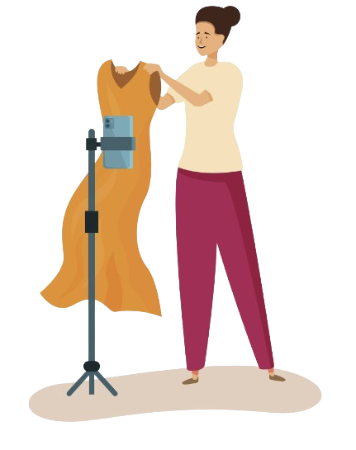
5
Customer Benefits
Enhanced Shopping Experience
Reduced Product Returns
Time and Cost Efficiency
Increased Confidence in Purchases

Slide 7
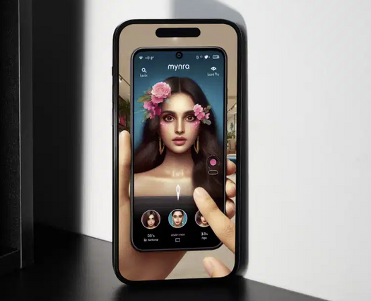
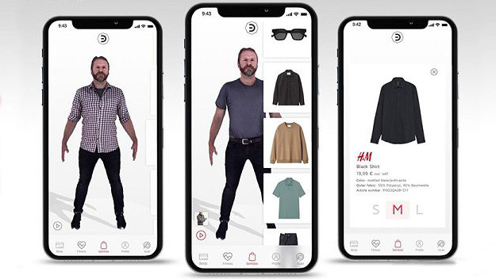
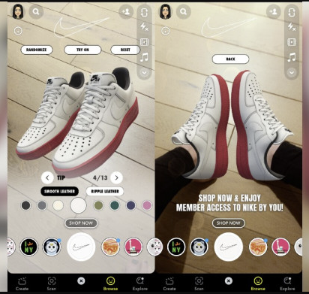

6
Existing Virtual Try-On Systems
H&M Virtual Try-On: Uses Avatar
Myntra Virtual Try-On: Uses Virtual Avatar
Snap AR Try-On (Powered by Snapchat): Partnered with
ecommerce brands like Gucci and Nike, mobile app only
IKEA Place (For non Clothing): similar approache

Slide 8
7
Features mentioned in proposal
Optimized E-commerce User Experience
2. Develop an AI-Driven Virtual Try-On Platform
3. Enhance Fit Accuracy Through Computer Vision
4. Provide Personalized Clothing Recommendations
5. Integrate Augmented Reality for Real-Time Interaction
6. Seamless Integration with E-Commerce Platforms
7. Data-Driven Insights for Retailers

Slide 9
8
Implementation Details
Browsing Without Login:
Users can explore categories and products without logging in.
User Authentication:
Login and signup system for access to advanced features.
Virtual Try-On Feature:
Allows users to visually "try on" products.
Cart Functionality:
Add products to the cart, even without logging in.
Order Creation:
Users can finalize purchases after logging in.
Admin Control Panel:
Add, modify, view, and delete products.

Slide 10

9
Implemented Features
User Section:
Browse Homepage
Add To Cart
Login/Signup
View and update Profile
Virtual try-on
Create orders

Slide 11

10
Implemented Features
Admin Section:
Add new products
Modify existing products
View all products
Delete products

Slide 12
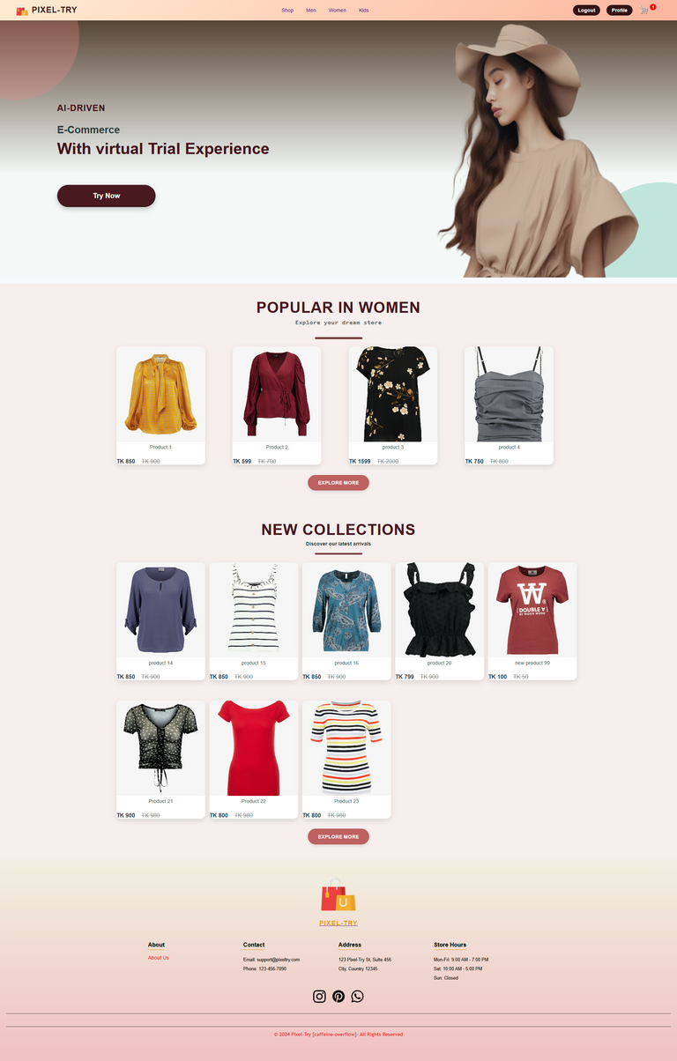
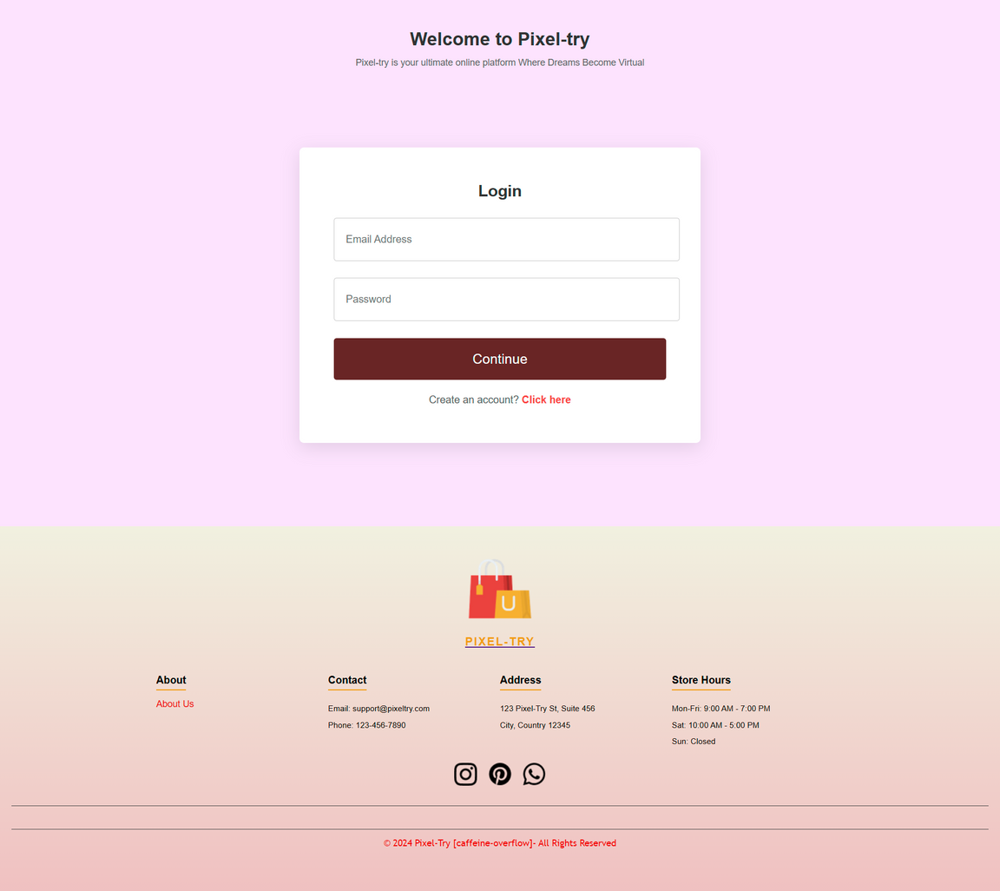
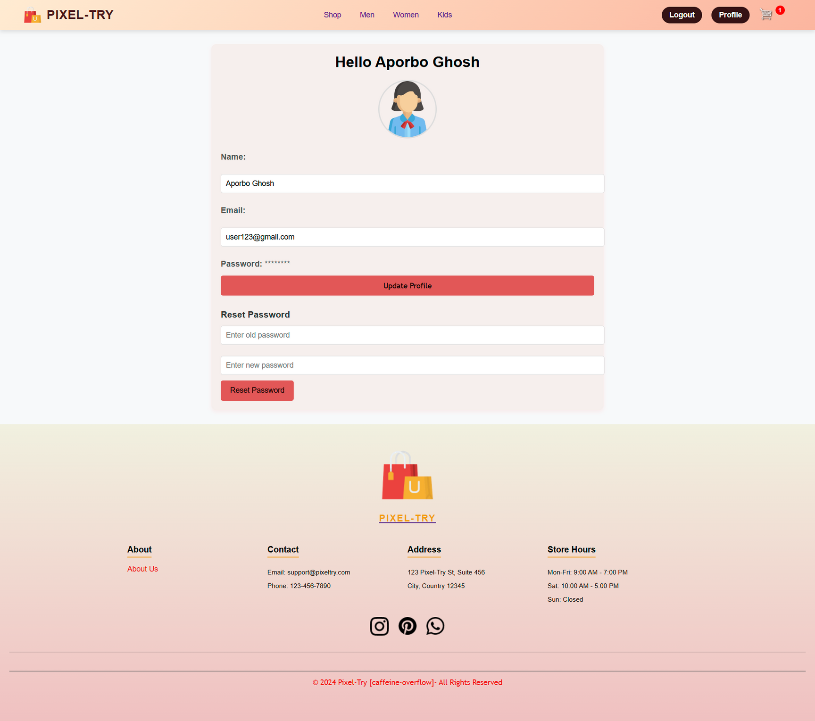
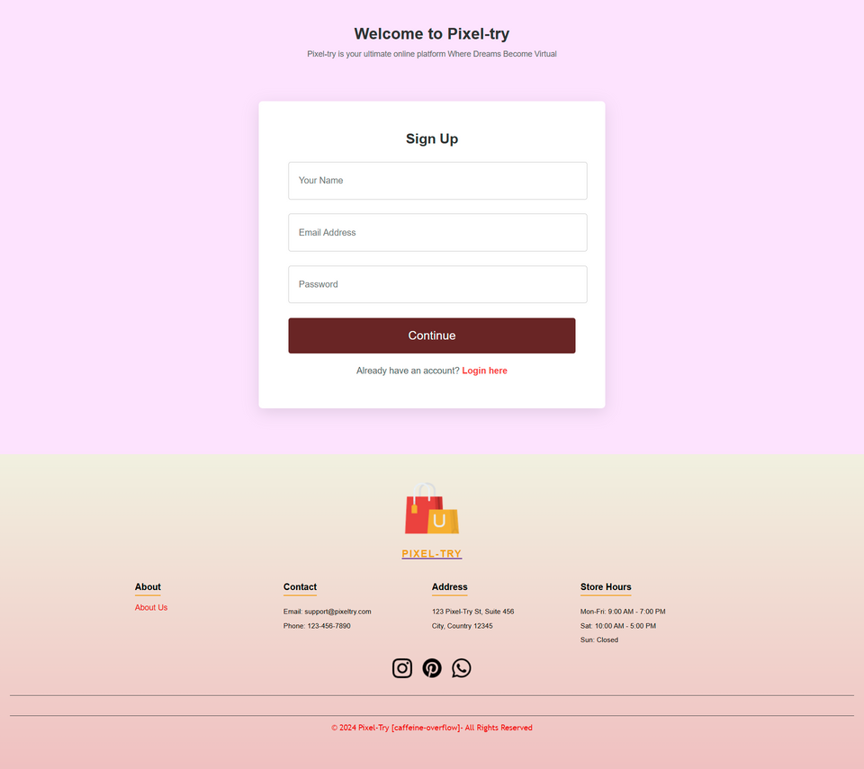
11
User Section:
Functional Details
Main User Interface:
Login and Signup:
User Profile:

Slide 13
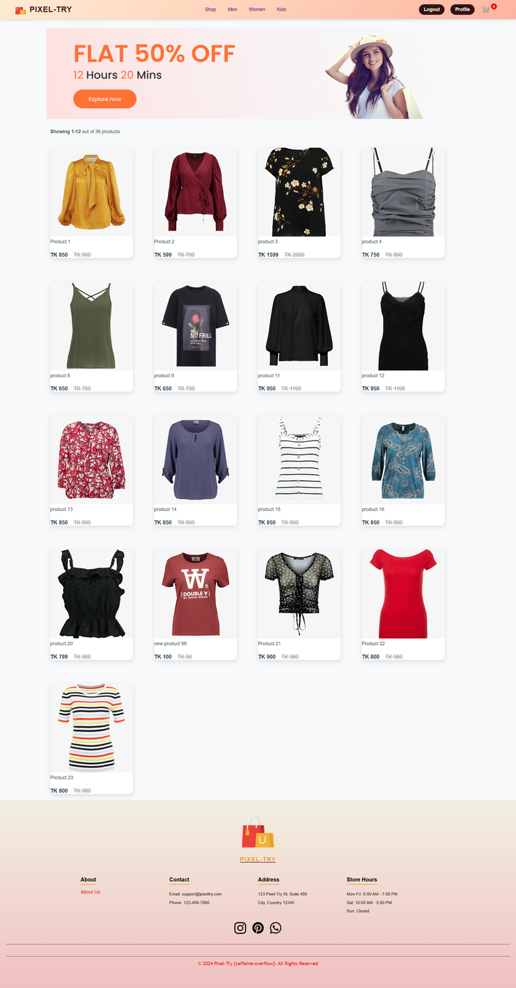
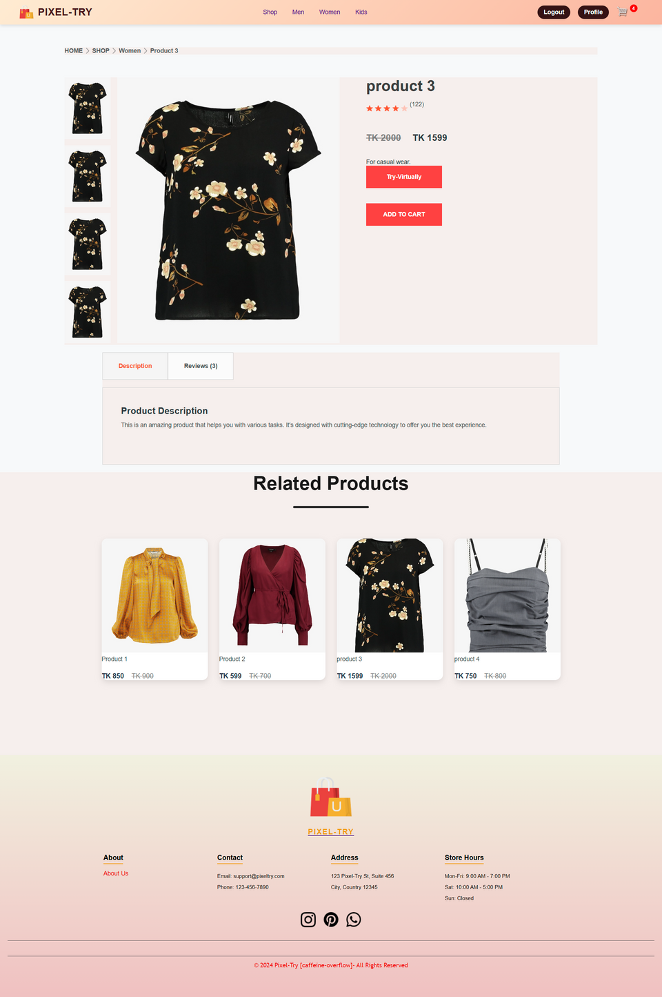
12
User Section:
Functional Details
Category-wise Product:
Product Display:

Slide 14

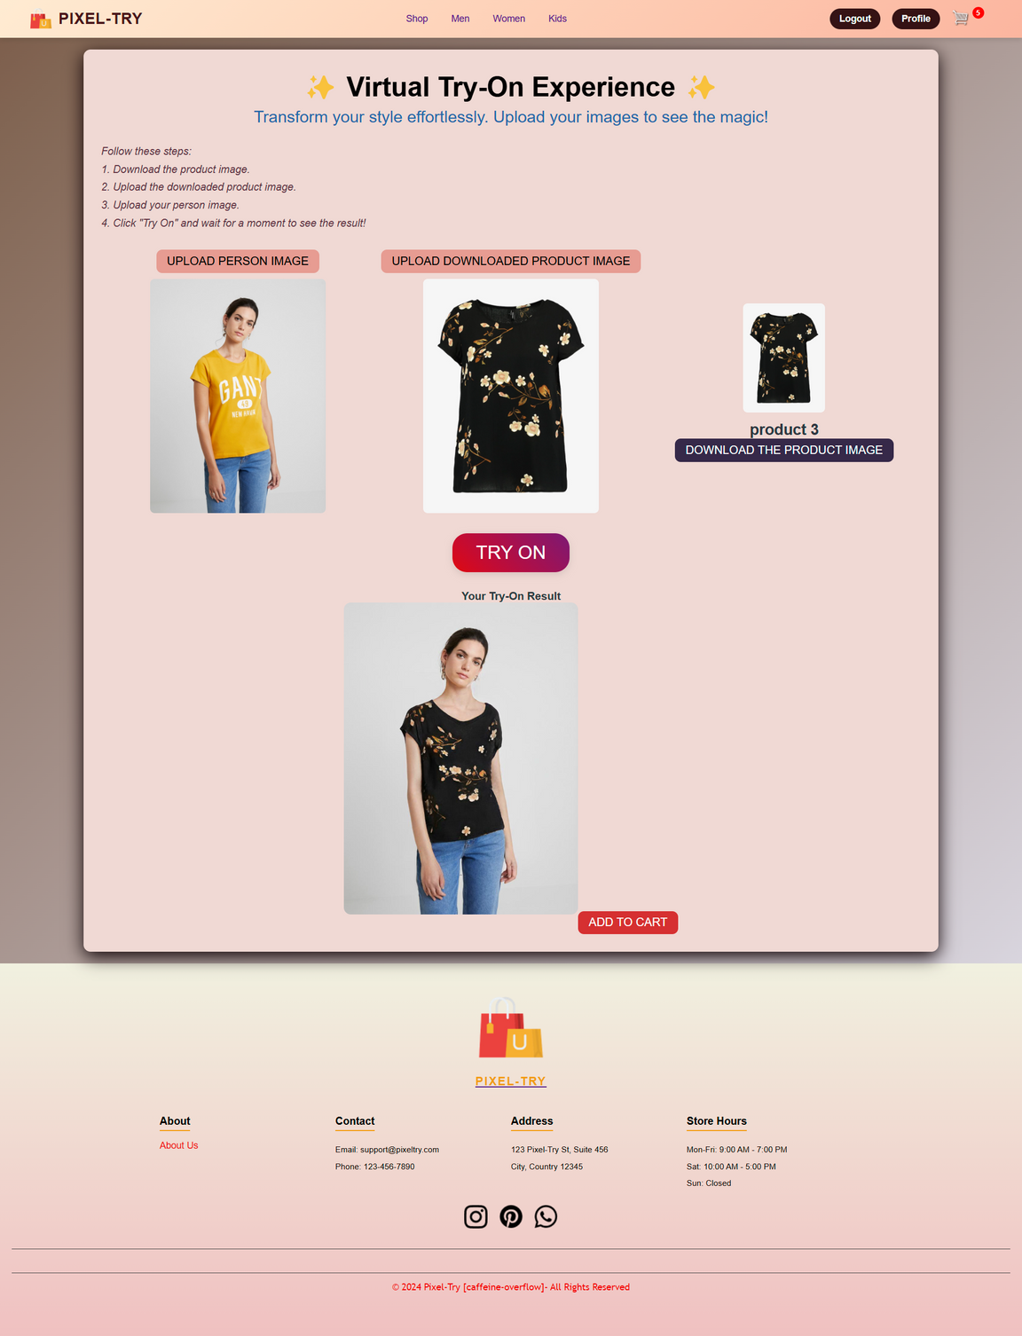
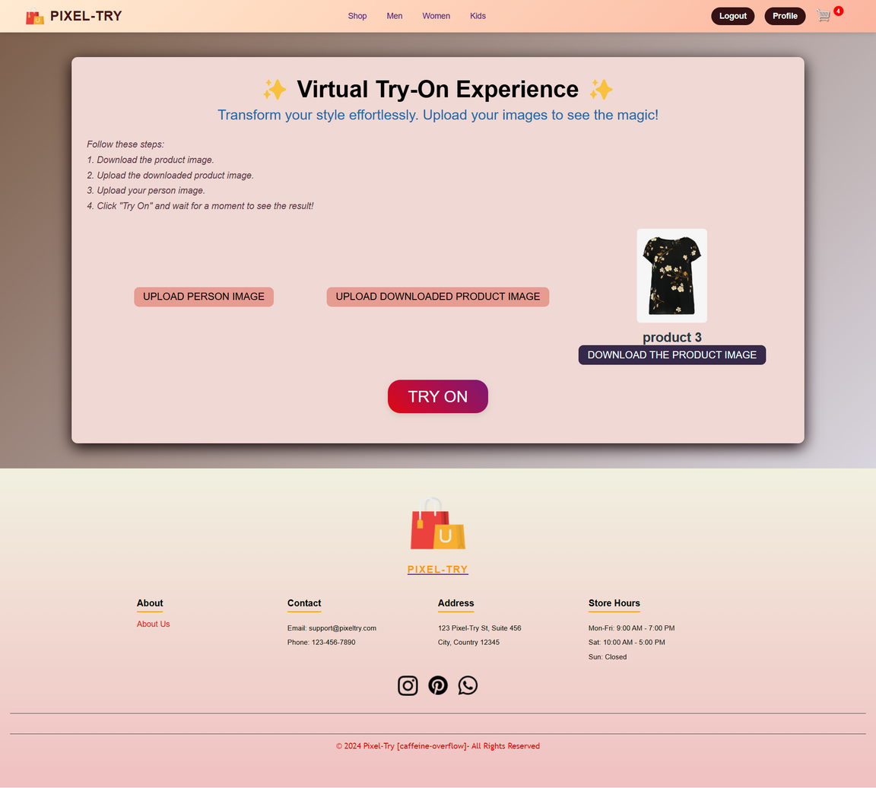
13
User Section:
Functional Details
After Trial
Virtual Try-On:
Before Trial

Slide 15
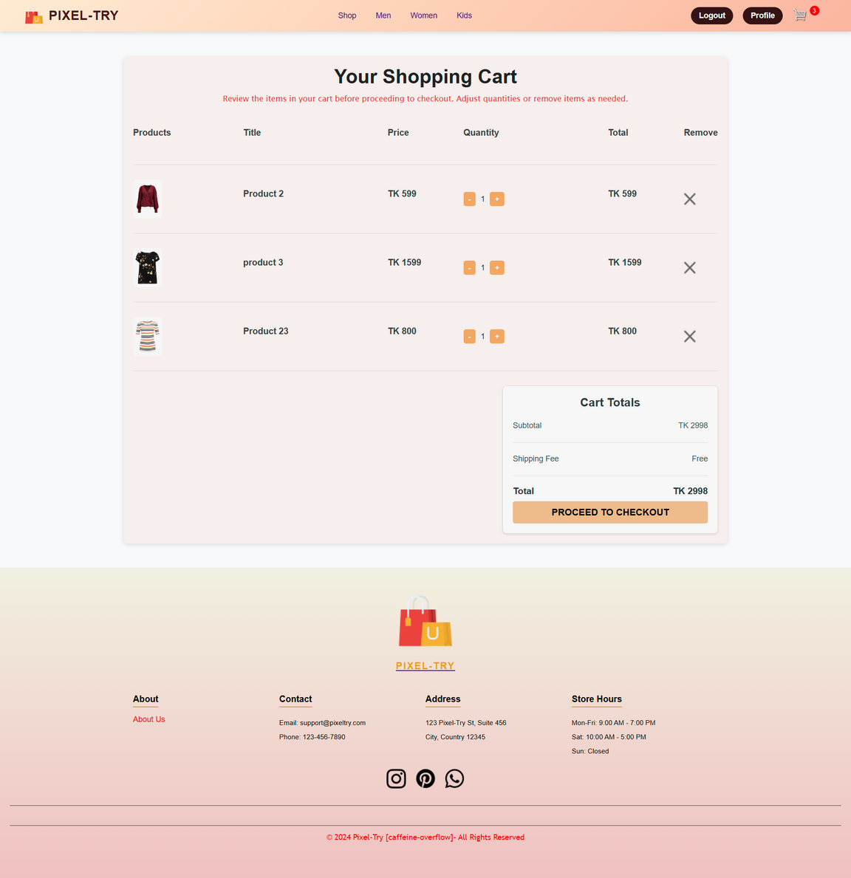
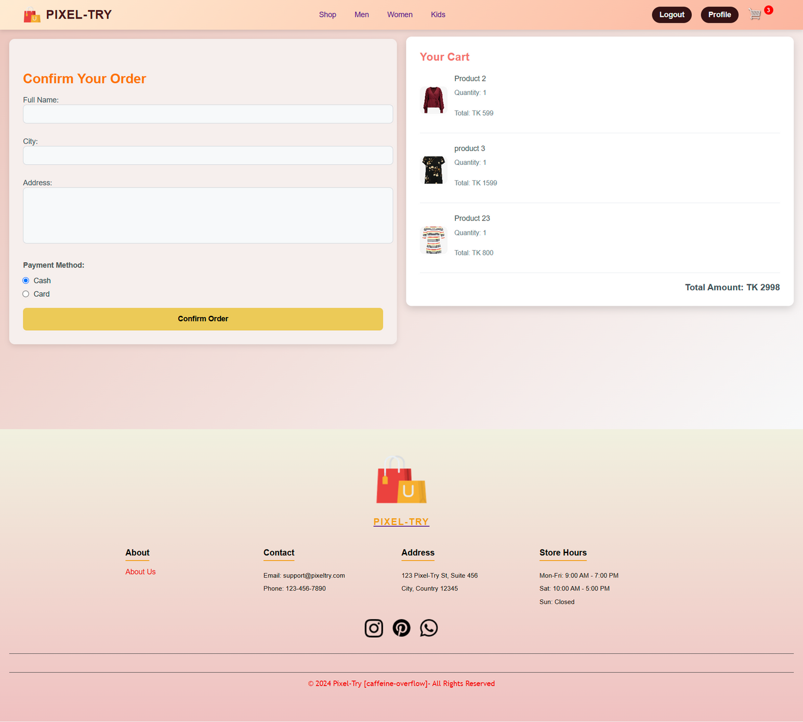
14
User Section:
Functional Details
Cart-Items:
Order Confirmation:

Slide 16
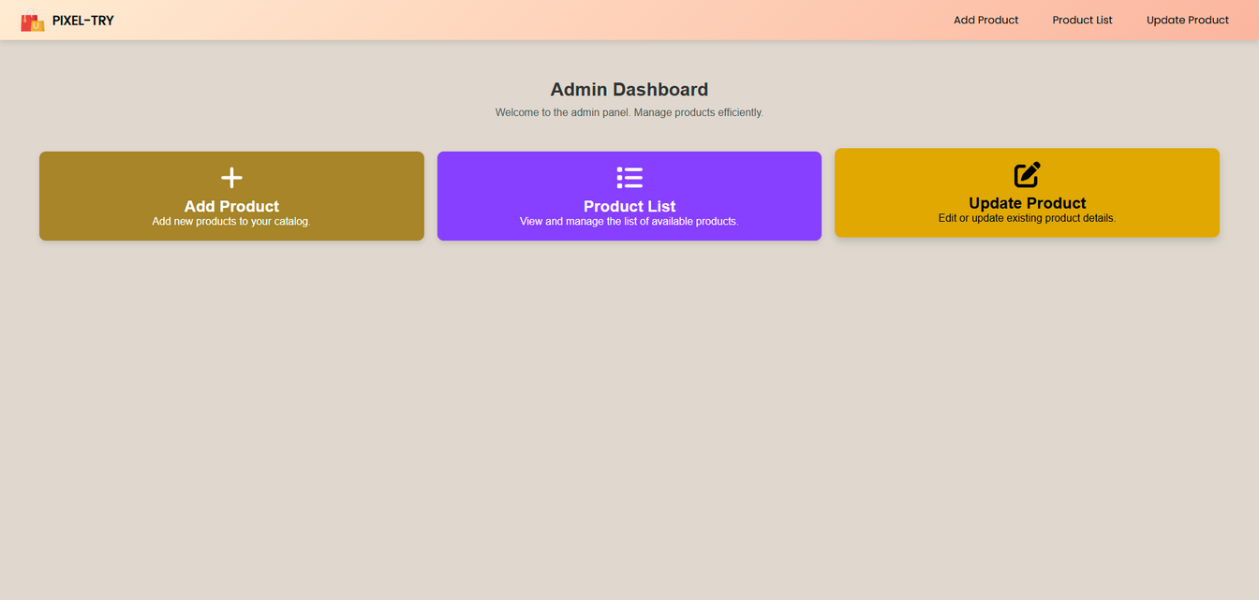
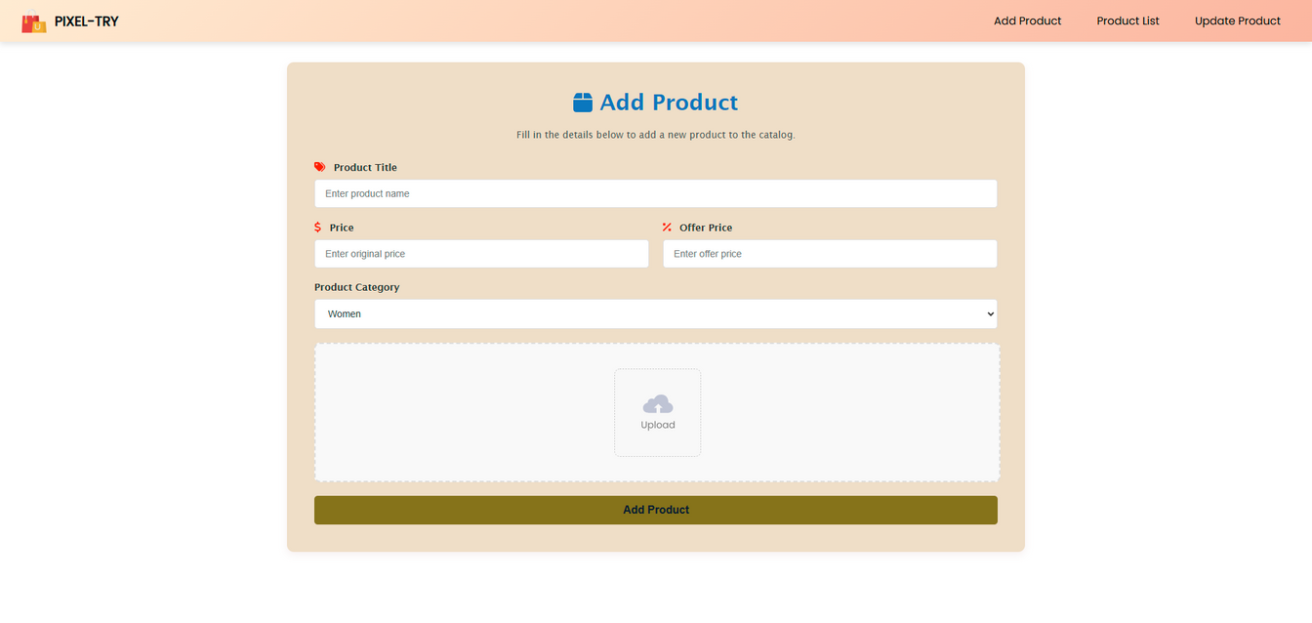
15
Admin Section
Functional Details
Homepage:
Add Product:

Slide 17
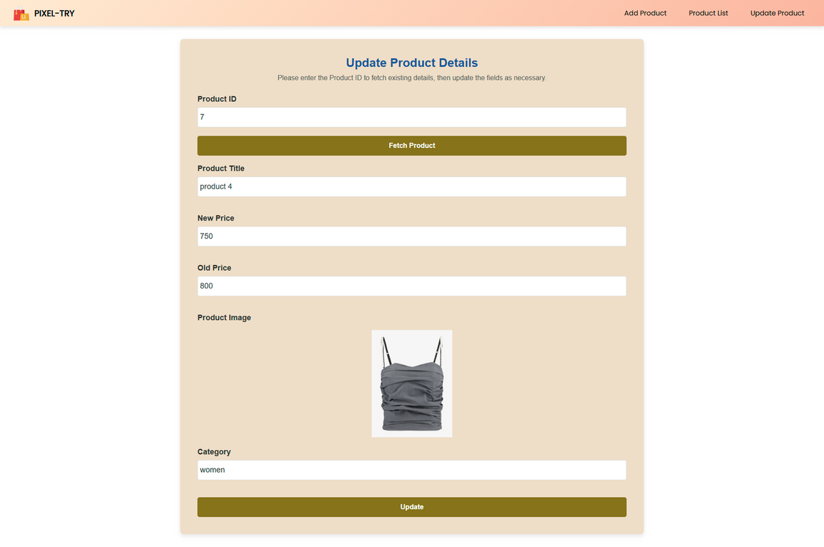
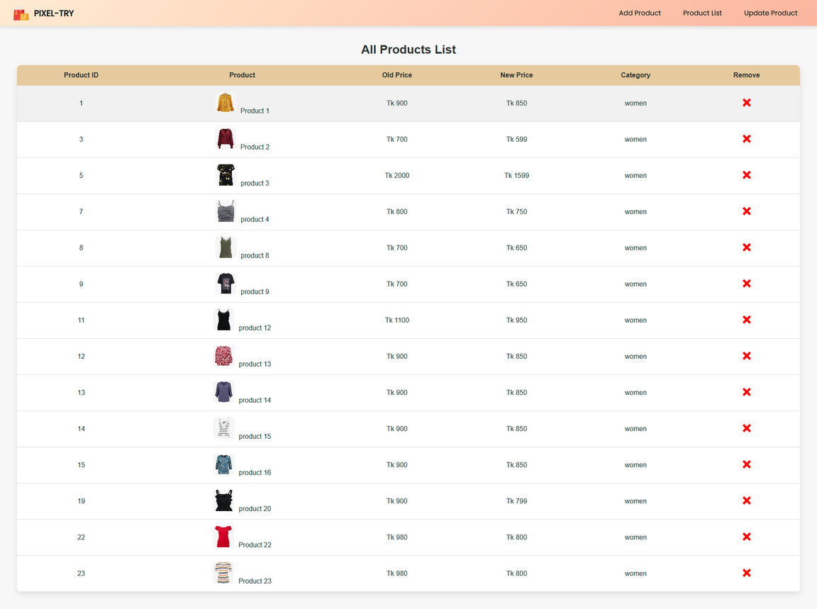
16
Admin Section
Functional Details
Update product:
Product List:

Slide 18
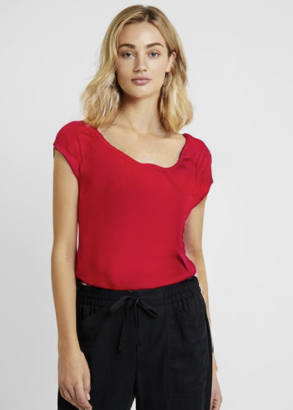
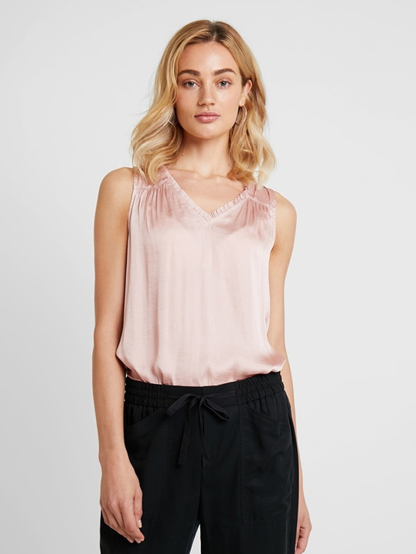
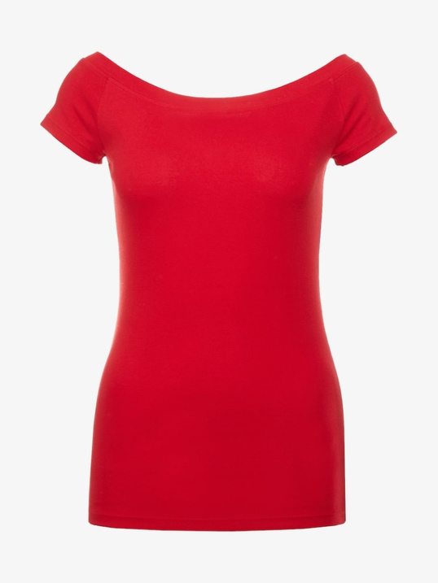


17
Special Feature
Virtual Trial:
User can view how a cloth will look on them in real-picture
Person Picture:
Product Picture:
Result:

Slide 19

18
Special Feature
?
Why this feature is
Boosting sales
Easy to access
Realistic Visualization
Reducing return rates
Accurate pose and cloth fitting Experience

Slide 20

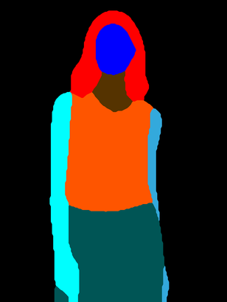


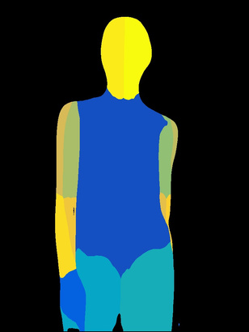
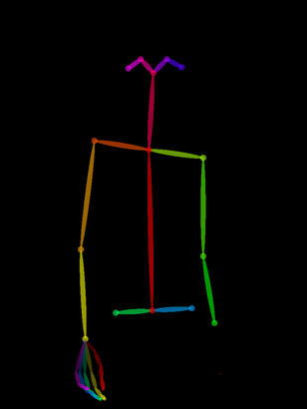
19
Special Feature
How the feature Works:
User uploads product and personal image.
System generates a product mask. DensePose, Person-Parse, and OpenPose of the user image.
Image-parse
Product-mask
Densepose
Openpose

Slide 21
20
Special Feature
How the feature Works:
After generating, A test pair is created with the clothing and user image.
Thin Plate Spline (TPS) Transformation and Geometric Matching Networks (GMNs) warps the clothing image to align with the body shape and pose
Image Synthesis: Combines inputs using GANs for realistic try-on.
Outputs realistic trial images for user visualization.

Slide 22
21
Methodology
Database Management
MongoDB for efficient storage and retrieval of user, product, and order data.
User Interface Development
Frontend: React.js for a responsive and interactive user interface.
Backend: Node.js with Express for handling API requests.
AI Training
Zolando_HD_resized dataset utilized for virtual try-on feature.
Machine learning models trained to map clothing items to user photos.

Slide 23









22
Tecnology Used
Frontend-
Backend-
Database-
Machine learning-
Tools and Platforms-

Slide 24
23
Not implemented Features
Order Management and authentication for admin
2. Personalized Clothing Recommendations for user
3. Web-Cam integration for user

Slide 25

24
Limitations
Time
2. High Computational Power
3. Low resulation real image dataset as per our project

Slide 26
25
Results
Evaluation Matrics:
SSIM (Structural Similarity Index): 0.895
Measures the similarity between the synthesized and original images (higher is better).
LPIPS (Learned Perceptual Image Patch Similarity): 0.053
A perceptual distance metric (lower is better).
FID (Fréchet Inception Distance): 11.74
Measures the quality of generated images by comparing the distribution of real and generated images in feature space (lower is better).

Slide 27
26
Future Enhancement
1. Personalized Clothing Recommendations for user
2. Digital Fashion Shows and Virtual Pop-Up Stores
3. Data-Driven Insights for Retailers
4. Webcam Integration for image and real-time video trial

Slide 28
27
Learning
Pose Estimation
API integration
OpenCV and Pytorch
GPU management for large data training
Team-work
Deadline management

Slide 29
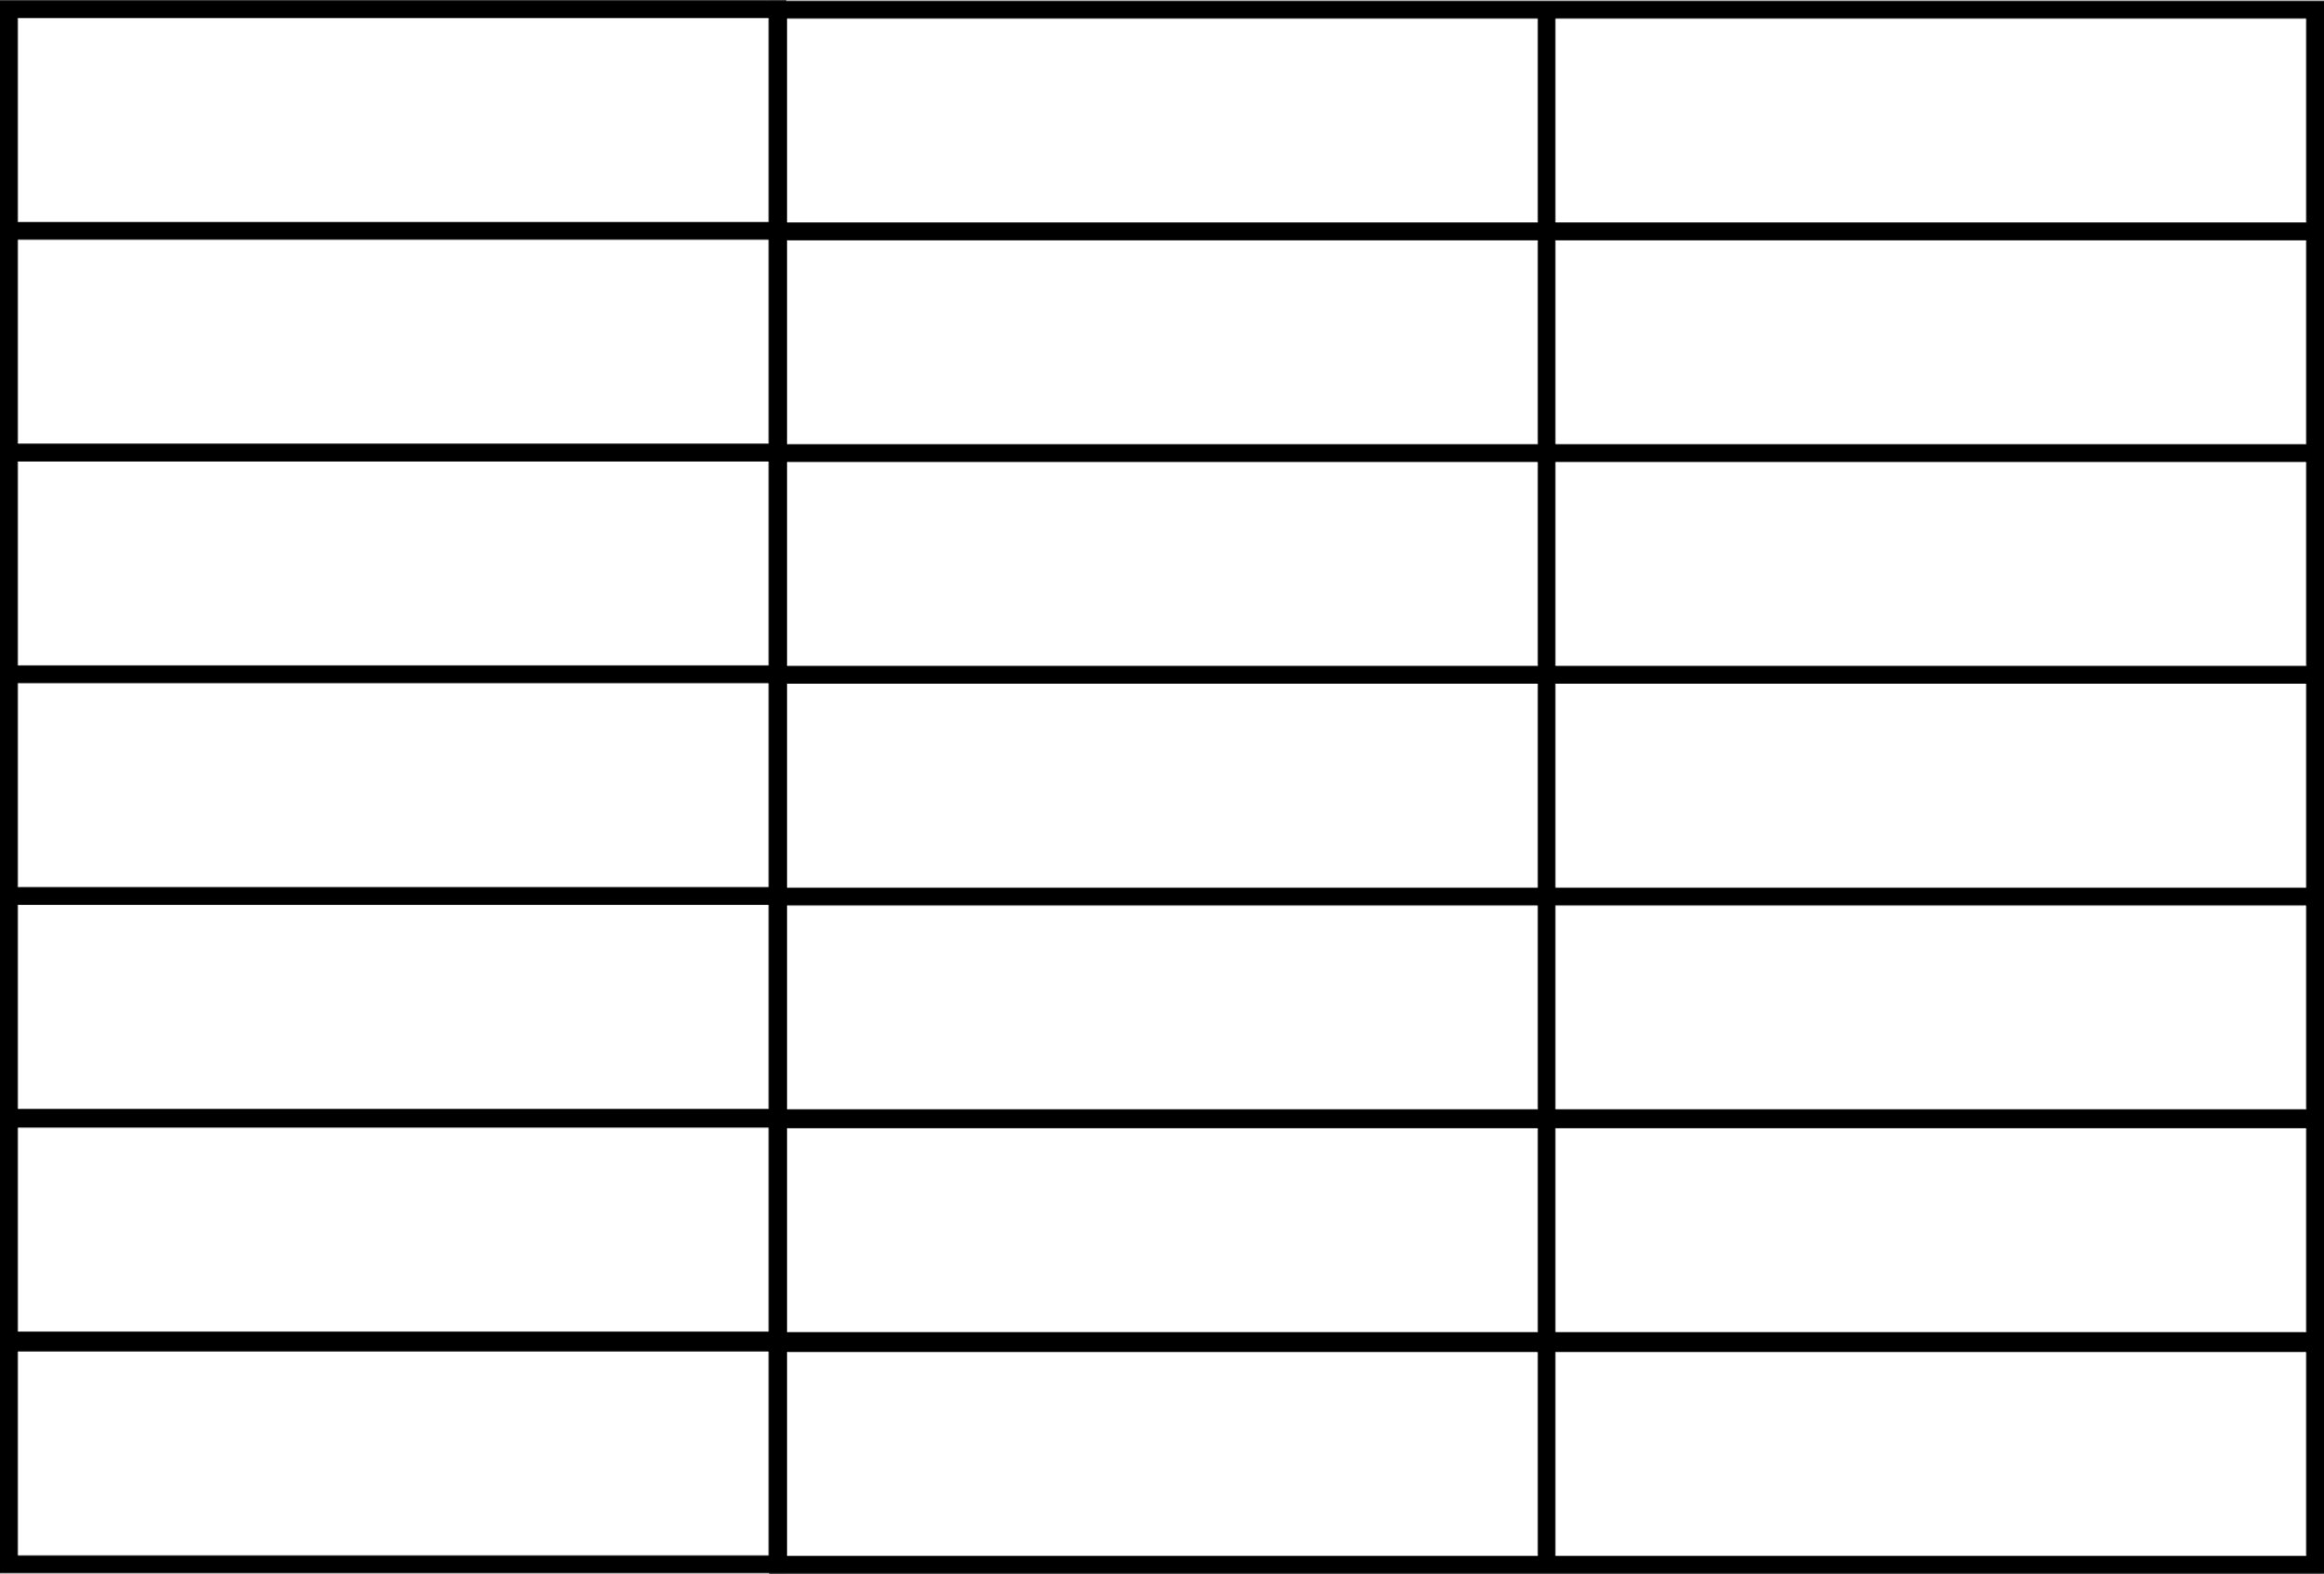
28
Week-wise Contribution
Name
Aporbo
Tasfia
week
Week 1
Data collection,
3D model development
Front-end setup,
AR initial integration
Week 2
3D model training
and refinement
Continued AR integration,
front-end development
Week 3
Complete 3D model
generation
Backend setup, complete
front-end for image uploads
Week 4
Test AI models
Begin testing AR
and user interactions
Optimize AI systems
UI refinement,
Integrate backend,
Week 5
Week 6
Final integration
Final system integration
and testing

Slide 30
29
Conclusion
This AI-driven virtual try-on system redefines online shopping by allowing users to see how clothes fit and look on them, enhancing confidence and reducing returns. By combining advanced computer vision and augmented reality, it delivers realistic and accurate try-on experiences. While current results are promising, with strong performance metrics, future updates like live webcam integration and personalized recommendations will make the system even more engaging and user-friendly, setting a new standard for e-commerce innovation.

Slide 31
30
Thank
YOu

